Slide 1
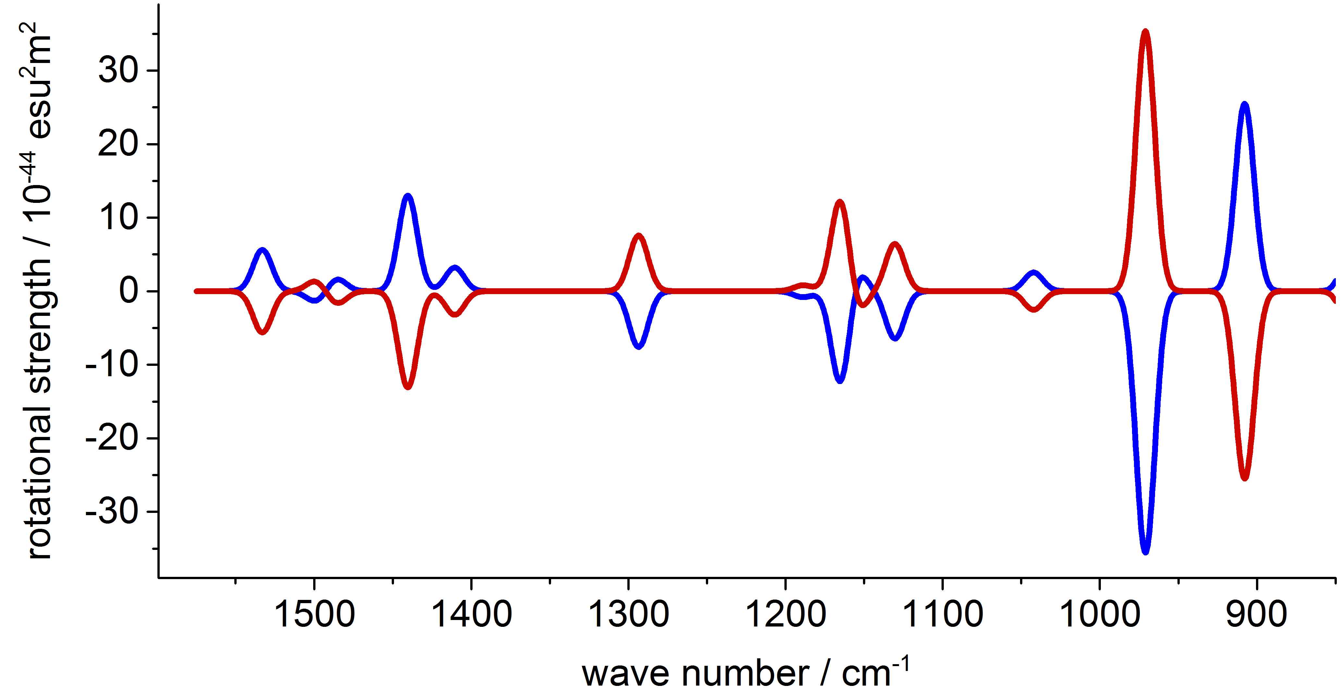
Vibrational circular dichroism spectra:
Theory, implementation and applications
Kevin Reiter

Slide 2
Vibrational circular dichroism spectra: Theory, implementation and applications
Theory and implementation
Vibrational circular dichroism
Symmetry exploitation
Chemical shieldings with effective core potentials
Applications
Co/Ir(ppy)₃
Carbon clusters with I symmetry ( and )
Summary and outlook

Slide 3
Vibrational circular dichroism: Theory and implementation

Slide 4
Theory and implementation
Determination of the absolute configuration of chiral molecules through measurement and calculation of VCD-intensities:
transition dipole moments: ground state → vibrational state
: transformation matrix from cartesian to normal coordinates
Atomic Polar Tensor (APT):

Slide 5
Theory and implementation
Atomic Axial Tensor (AAT):
Necessary for : Change of the orbitals with respect to the magnetic field:

Slide 6
Theory and implementation
also necessary for chemical shieldings (module mpshift)
Gauge Including Atomic Orbitals (GIAOs)
Extension of the module (aoforce) for the calculation of the vibrational states:

Slide 7
Theory and implementation
new integrals to be calculated:
→ linearcombination of dipole integrals
→ linearcombination of dipole derivative integrals

Slide 8
How to run
Calculation of a VCD-spectrum:
write $vcd into the control file
Call mpshift
will be written to file
call aoforce
reading from file
Performing the actual VCD-intensity calculation
You can use the script vcd which calls the two modules after each other

Slide 9
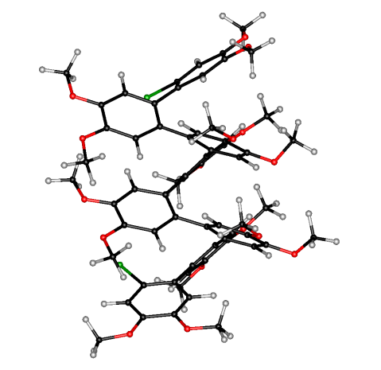
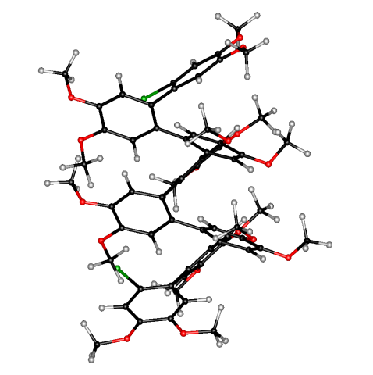
Application
Br₂C₆₄O₁₆H₆₄
CPU time / h: mpshift aoforce(1 CPU) aoforce(10 CPUs)
BP86/SV(P) 0.7 97 13

Slide 10
Vibrational circular dichroism: symmetry exploitation

Slide 11
Symmetry exploitation
Only molecules with chiral point groups have non-vanishing VCD intensities:
→ C₁, C_{n}, D_{n}, T, O and I
Full support of symmetry for C_{n=2}, D_{n}, O and I
Module mpshift can’t handle reducible e-representations (C_{n>2} and T)
Calculation of the Wavefunction with symmetry
Transformation of the MOs to C₁ with a subsequent calculation of in C₁
Call of the module aoforce with symmetry
The script vcd and the modules aoforce and mpshift will stop the execution
for all the other, nonchiral point groups

Slide 12
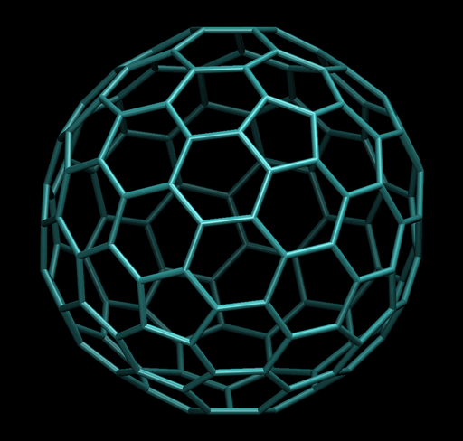
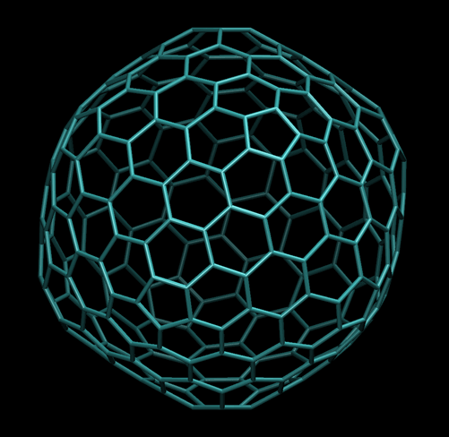

Application: Carbon clusters with I symmetry
method: BP86/def2-SVP
CPU time / h: symmetry mpshift aoforce (1CPU)
( ) C₁ 2.3 245.4 I 0.3 10.1
2 ( ) I 1.1 67.8

Slide 13
Chemical shieldings with effective core potentials: Theory and implementation

Slide 14
Effective core potentials
Heavy elements (→ metallopolymers): relativistic effects (also) affect the valence shell and hence the chemical shieldings at the neighboring atoms
Those effects can be treated by the use of Effective Core Potentials (ECPs) V^{C} and Gauge Including Atomic Orbitals (GIAOs):
Hamiltonian in a magnetic field:

Slide 15
Effective core potentials
Gauge invariance:
Expansion of the basis functions and the operator in powers of B

Slide 16
Effective core potentials
Now we expand and obtain terms linear and quadratic in B
Overall result for terms linear in B

Slide 17
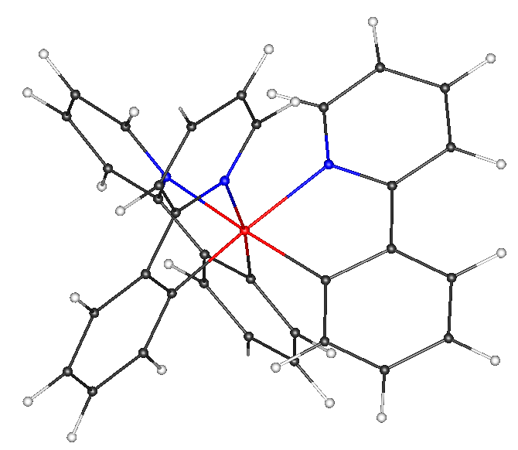
Effective core potentials
ECP Terms:
Has been implemented in TURBOMOLE`s module mpshift and tested e.g. at M(ppy)₃, M = Ir, Co ppy = 2-Phenylpyridine
Expansion of the basis functions and the operator in powers of B

Slide 18
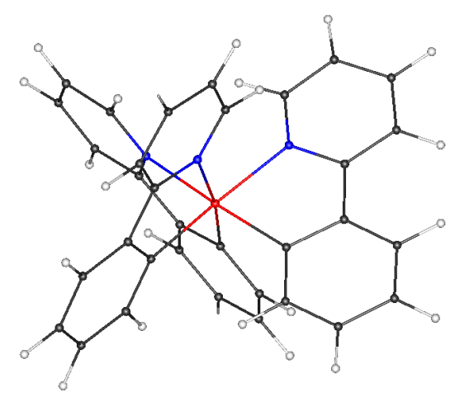
Effective core potentials: application
method: BP86/SV(P)
CPU time: 8 min (ECP)
8 min (all-electron)
Displacement by 10 a.u. in direction
N
C3
C2
C1
M(ppy)₃

Slide 19
Effective core potentials: application
Displacement by 10 a.u. in direction
N
C3
C2
C1
M(ppy)₃

Slide 20
Effective core potentials: application
60
N
tr(σ)
40
C2
C3
Co(ppy)₃
C2
20
C3
C1
0
C1
-20
N
M(ppy)₃
-20
0
20
40
60
Ir(ppy)₃
tr(σ)

Slide 21

VCD with effective core potentials
Co(ppy)₃

Slide 22
VCD with effective core potentials
Co(ppy)₃

Slide 23
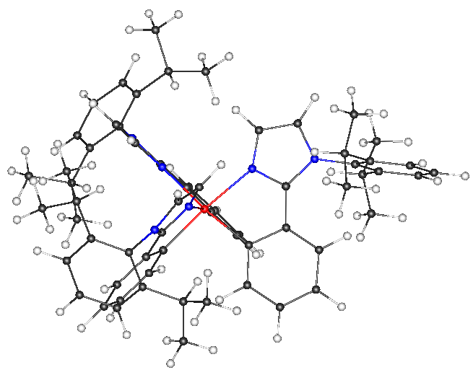
VCD with effective core potentials
(1)
M=Ir
(2)
CPU time / h: mpshift aoforce(8 CPUs)
1 (61 atoms) 0.1 1.7
2 (139 atoms) 0.5 12.7

Slide 24
Summary
Calculation of VCD-Spectra with symmetry exploitation implemented
Calculation of chemical shieldings for molecules with heavy elements by the use of ECPs
VCD spectra for molecules with heavy elements
Treatment of solvent effects with COSMO for chemical shieldings and VCD spectra
Outlook

Slide 25
References
Cheeseman, J. R., et al., Chem. Phys. Lett. 252 (1996) 211-220.
Nicu, Valentin Paul, et al., Theor. Chem. Acc. 119 (2008) 245-263.
van Wüllen, Christoph, J. Chem. Phys. 36.11 (2012) 114110.
Thank you for your attention!

